Slide 1
Refactoring Toward Deeper Insight
PRESENTED BY:
Sergey Tantsyura
Maxim Nakhod
Date: December 19, 2019

Slide 2
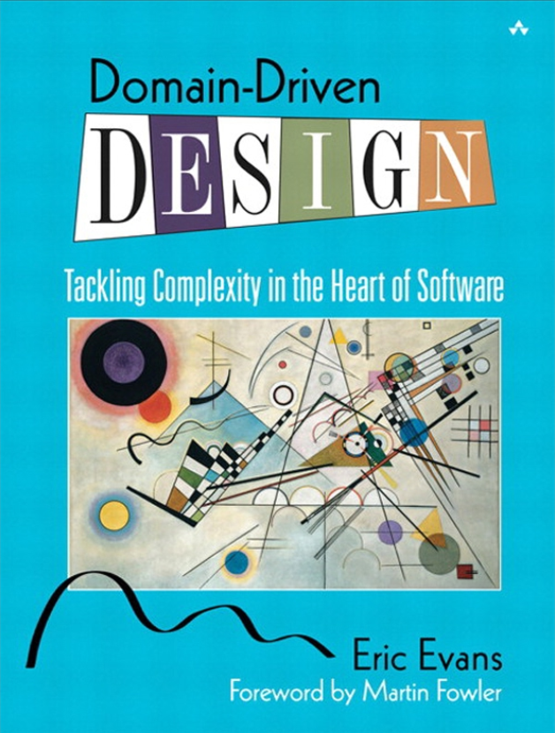

Disclaimer
Content of this training is based on Domain-Driven Design, Tackling Complexity in the Heart of Software by Eric Evans.
This book was published in 2003 and Eric Evans introduced Domain-Driven Design term.
This book is the primary source of knowledge on Domain-Driven Design topic, though it may be a bit hard to read.

Slide 3
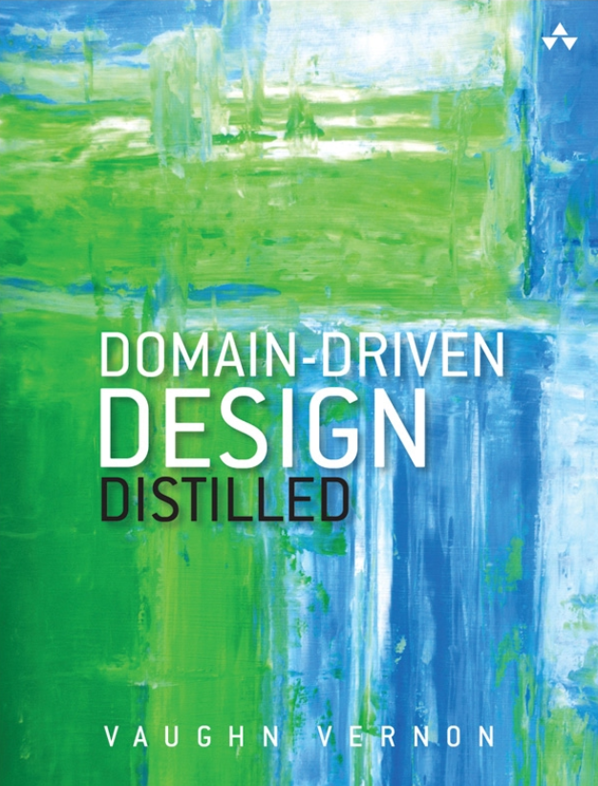
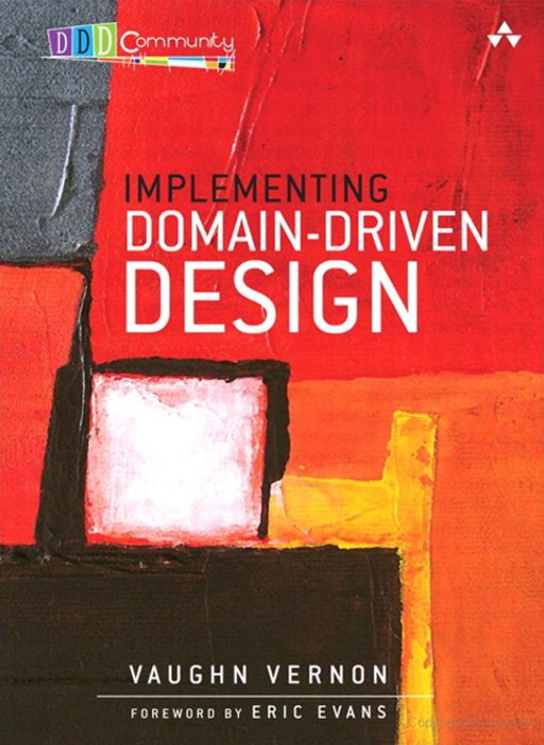
Other Books on DDD Topic
Domain-Driven Design Distilled by Vaughn Vernon | Implementing Domain-Driven Design by Vaughn Vernon

Slide 4

Presentation and Examples on GitHub
This presentation and all examples can be found on GitHub:
https://github.com/tantsyurasergey/DDDTraining

Slide 5
Agenda
01
02
03
04
05
06
07
Recap of Previous Meeting
Breakthrough
Making Implicit Concepts Explicit
Supple Design
Applying Analysis Patterns
Relating Design Patterns to the Model
Refactoring Toward Deeper Insight
Notes:
STA: 01 + 02 (7 slides), 04 (8 slides), 07 + Key Takeaways (6 slides)
MN: 03 (7 slides), 05 + 06 (8 slides)

Slide 6
Recap of Previous Meeting

Slide 7

Previously on DDD
DDD

Slide 8
Previously on DDD
Define Domain Model in collaboration with domain experts. This process is iterative, many models are tried and rejected or transformed.
Establish Ubiquitous Language. Use the model as the backbone of the language. Commit the team to exercising that language relentlessly in all communication within the team and in the code.
Make design of the software system reflect the domain model in a very literal way, so that mapping is obvious. The code becomes an expression of the model, so a change to the code may be a change to the model.
Partition a complex program into layers. Concentrate all the code related to the domain model in one layer and isolate it from the user interface, application, and infrastructure code.

Slide 9
Previously on DDD
Express Model in software with:
Entities
Value Objects
Services
Modules
Encapsulate creation of complex Entities, Value Objects or Aggregates with Factories.
Maintain integrity of Entities with Aggregates.
Access Entities and Aggregates with Repositories.

Slide 10
Interesting Questions from Previous Meeting
Sharing model between UI/mobile application and backend service
DDD is meant to address business logic complexity, and business logic doesn't belong to the frontend.
UI/mobile apps work with a limited representation of domain objects.
Domain Driven Design and Reports
Command Query Responsibility Segregation (CQRS) is a solution.
Lazy loading in Aggregates
AGGREGATES mark off the scope within which invariants have to be maintained at every stage of the life cycle. Consistency rules, not the structure, drive the requirements for AGGREGATES.
It is necessary to redesign AGGREGATES if current design makes you think about lazy loading.

Slide 11
Breakthrough

Slide 12

Developing useful models
Success developing useful models comes down to three points:
Sophisticated domain models are achievable and worth the trouble.
They are seldom developed except through an iterative process of refactoring, including close involvement of the domain experts with developers interested in learning about the domain.
They may call for sophisticated design skills to implement and to use effectively.

Slide 13
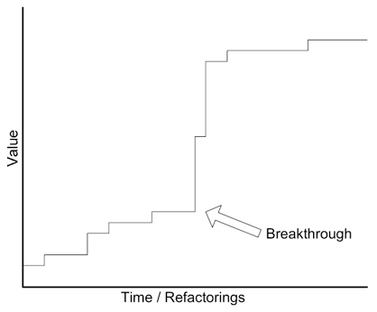
Breakthrough
Continuous refactoring prepares the way for something less orderly. Each refinement of code and model gives developers a clearer view. This clarity creates a potential for a breakthrough of insights. A rush of change leads to a model that corresponds on a deeper level to the realities and priorities of the users.

Slide 14
Making Implicit Concepts Explicit

Slide 15

Making Implicit Concepts Explicit
Many transformations of domain models and the corresponding code happen when developers recognize a concept that has been hinted at in discussion or present implicitly in the design, and they then represent it explicitly in the model with one or more objects or relationships.
Occasionally, this transformation of a formerly implicit concept into an explicit one is a breakthrough that leads to a deep model.

Slide 16

Less Obvious Kinds of Concepts
The object-oriented paradigm leads us to look for and invent certain kinds of concepts. Things are the meat of most object models, along with the actions those things take. But other important categories of concepts can be made explicit in a model as well.
We’ll discuss three such categories that may not be obvious:
Explicit Constraints
Processes as Domain Objects
Specification

Slide 17
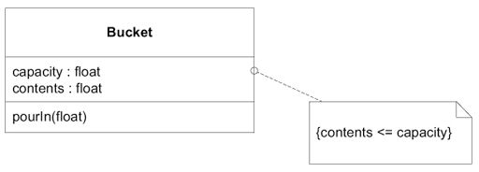
Explicit Constraints
Constraints make up a particularly important category of model concepts.
They often emerge implicitly, and expressing them explicitly can greatly improve a design.
Factoring the constraint into its own method allows us to give it an intention-revealing name that makes the constraint explicit in our design.

Slide 18

Processes as Domain Objects
Business processes that exist in domain may be represented as domain objects.
The key to distinguishing a process that ought to be made explicit from one that should be hidden is simple: Is this something the domain experts talk about, or is it just part of the mechanism of the computer program?
Process can be represented as SERVICE or as a STRATEGY (when there is more than one way to carry out a process).

Slide 19
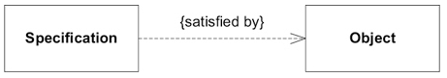
Specification
A SPECIFICATION is a predicate that determines if an object does or does not satisfy some criteria.
Business rules often do not fit the responsibility of any of the obvious ENTITIES or VALUE OBJECTS, and their variety and combinations can overwhelm the basic meaning of the domain object. In such cases business rules may be moved to SPECIFICATION objects.

Slide 20
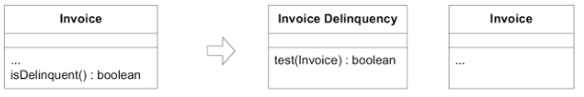
Use Cases For Specification
Validation - to validate an object to see if it fulfills some need or is ready for some purpose.
Selection or querying - to select an object from a collection.
Building to Order (Generating) - to specify the creation of a new object to fit some need.

Slide 21
Supple Design

Slide 22
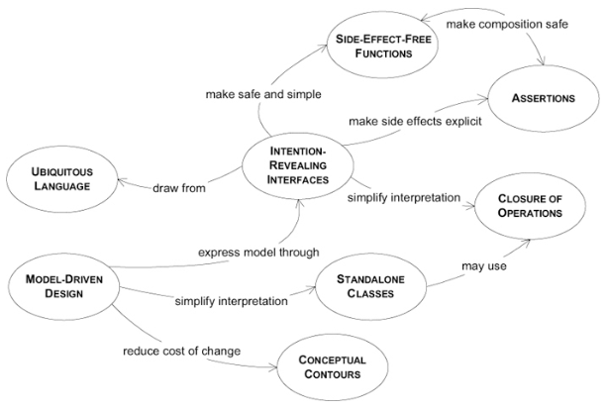
Patterns That Contribute to Supple Design

Slide 23
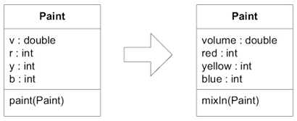
Intention-Revealing Interfaces
Name classes and operations to describe their effect and purpose, without reference to the means by which they do what they promise. This relieves the client developer of the need to understand the internals.
These names should conform to the UBIQUITOUS LANGUAGE so that team members can quickly infer their meaning.
Write a test for a behavior before creating it, to force your thinking into client developer mode.
Notes:
If a developer must consider the implementation of a component in order to use it, the value of encapsulation is lost.
If someone other than the original developer must infer the purpose of an object or operation based on its implementation, that new developer may infer a purpose that the operation or class fulfills only by chance.
If that was not the intent, the code may work for the moment, but the conceptual basis of the design will have been corrupted, and the two developers will be working at cross-purposes.

Slide 24
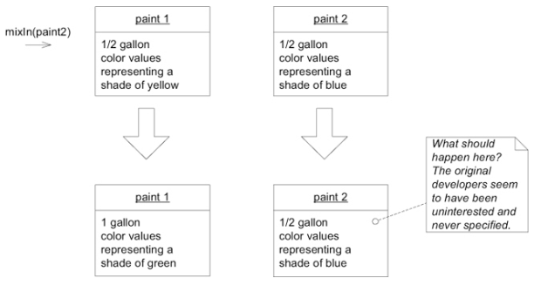
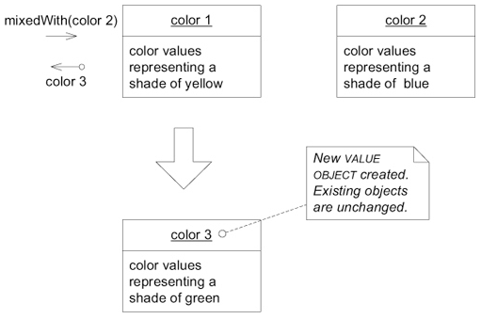
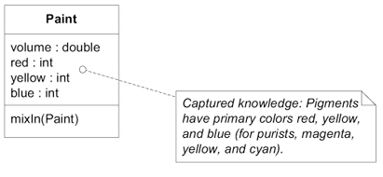
Side-Effect-Free Functions
Place as much of the logic as possible into functions, operations that return results with no observable side effects.
Strictly segregate commands (methods that result in modifications to state) into very simple operations that do not return domain information.
Further control side effects by moving complex logic into VALUE OBJECTS when a concept fitting the responsibility presents itself.
Notes:
Interactions of multiple rules or compositions of calculations become extremely difficult to predict. The developer calling an operation must understand its implementation and the implementation of all its delegations in order to anticipate the result.
The usefulness of any abstraction of interfaces is limited if the developers are forced to pierce the veil. Without safely predictable abstractions, the developers must limit the combinatory explosion, placing a low ceiling on the richness of behavior that is feasible to build.

Slide 25
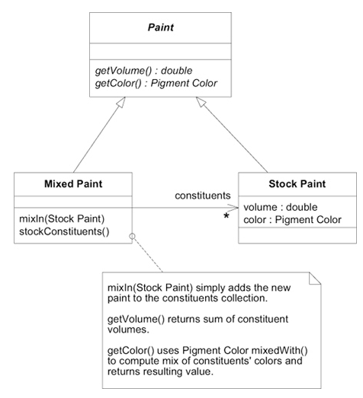
Assertions
State post-conditions of operations and invariants of classes and AGGREGATES.
If ASSERTIONS cannot be coded directly in your programming language, write automated unit tests for them.
Write them into documentation or diagrams where it fits the style of the project’s development process.
Notes:
When the side effects of operations are only defined implicitly by their implementation, designs with a lot of delegation become a tangle of cause and effect. The only way to understand a program is to trace execution through branching paths. The value of encapsulation is lost. The necessity of tracing concrete execution defeats abstraction.

Slide 26
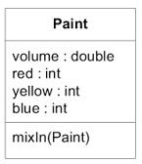
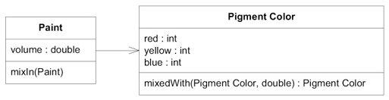

Conceptual Contours
Decompose design elements (operations, interfaces, classes, and AGGREGATES) into cohesive units, taking into consideration your intuition of the important divisions in the domain.
Observe the axes of change and stability through successive refactorings and look for the underlying CONCEPTUAL CONTOURS that explain these patterns.
Notes:
When elements of a model or design are embedded in a monolithic construct, their functionality gets duplicated.
The external interface doesn’t say everything a client might care about.
Their meaning is hard to understand, because different concepts are mixed together.
On the other hand, breaking down classes and methods can pointlessly complicate the client, forcing client objects to understand how tiny pieces fit together.
Worse, a concept can be lost completely. Half of a uranium atom is not uranium. And of course, it isn’t just grain size that counts, but just where the grain runs.

Slide 27
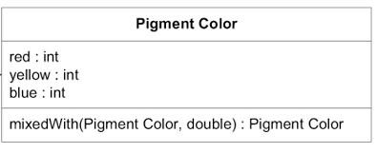
Standalone classes
Low coupling is fundamental to object design. When you can, go all the way. Eliminate all other concepts from the picture. Then the class will be completely self-contained and can be studied and understood alone. Every such self-contained class significantly eases the burden of understanding a MODULE.
Notes:
Even within a MODULE, the difficulty of interpreting a design increases wildly as dependencies are added. This adds to mental overload, limiting the design complexity a developer can handle. Implicit concepts contribute to this load even more than explicit references.
The concept of paint is fundamentally related to the concept of color. But color, even of pigment, can be considered without paint. By making these two concepts explicit and distilling the relationship, the remaining one-way association says something important, and the Pigment Color class, where most of the computational complexity lies, can be studied and tested alone.

Slide 28
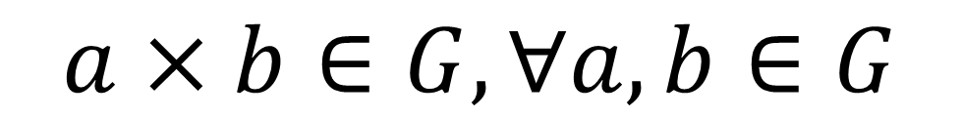
Closure of Operations
Where it fits, define an operation whose return type is the same as the type of its argument(s).
If the implementer has state that is used in the computation, then the implementer is effectively an argument of the operation, so the argument(s) and return value should be of the same type as the implementer. Such an operation is closed under the set of instances of that type.
A closed operation provides a high-level interface without introducing any dependency on other concepts.
This pattern is most often applied to the operations of a VALUE OBJECT.
$$a×b∈G,∀a,b∈G$$
Notes:
Most interesting objects end up doing things that can’t be characterized by primitives alone. Common practice in refined designs is what I call “CLOSURE OF OPERATIONS”. The name comes from that most refined of conceptual systems, mathematics. 1 + 1 = 2. The addition operation is closed under the set of real numbers.

Slide 29
Applying Analysis Patterns

Slide 30
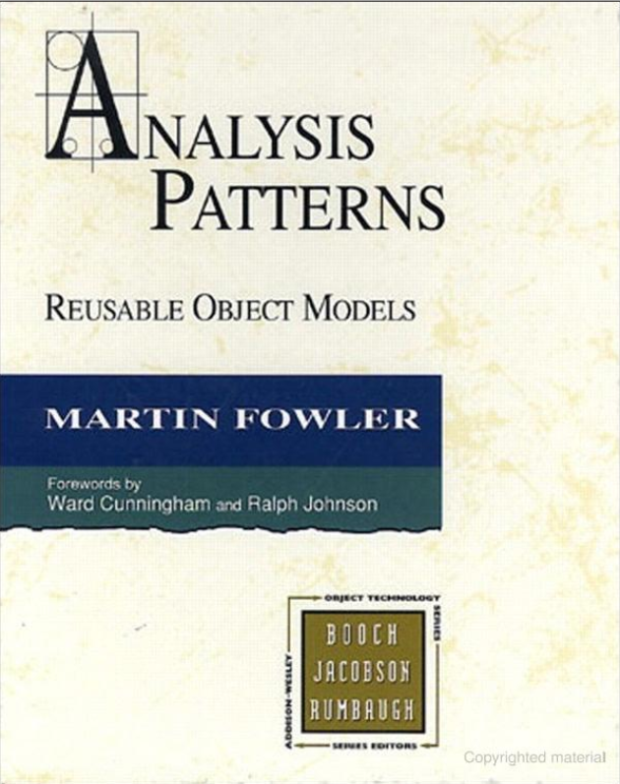
Definition of Analysis Patterns
In Analysis Patterns: Reusable Object Models, Martin Fowler defined his patterns this way:
Analysis patterns are groups of concepts that represent a common construction in business modeling. It may be relevant to only one domain or it may span many domains.

Slide 31
Analysis Patterns are Knowledge to Draw On
When you are lucky enough to have an analysis pattern, it hardly ever is the answer to your particular needs.
Yet it offers valuable leads in your investigation, and it provides cleanly abstracted vocabulary.
It should also give you guidance about implementation consequences that will save you pain down the road.

Slide 32
Relating Design Patterns to the Model

Slide 33
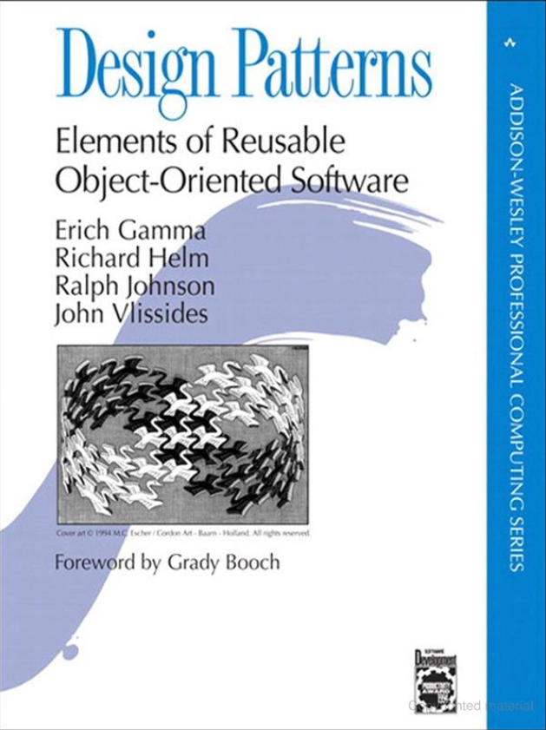
Difference Between Design Patterns and Domain Patterns
Some, not all, of the patterns in Design Patterns can be used as domain patterns. Doing so requires a shift in emphasis.
Design Patterns presents a catalog of design elements that have solved problems commonly encountered in a variety of contexts. These patterns are presented in purely technical terms.
But a subset of these elements can be applied in the broader context of domain modeling and design, as they correspond to general concepts that emerge in many domains.
Notes:
A sample of specific patterns form Design Patterns will show how a pattern conceived as a design pattern can be applied in the domain model, and it will clarify the distinction between a technical design pattern and a domain pattern.
STRATEGY demonstrates how some of the classic design patterns can be applied to domain problems by thinking about them in a different way.

Slide 34
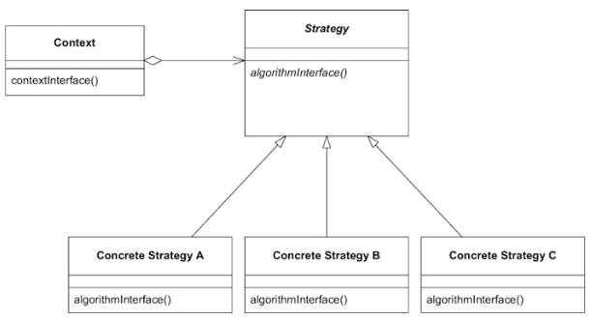
Strategy (a.k.a. Policy)
In computer programming, the strategy pattern (also known as the policy pattern) is a behavioral software design pattern that enables selecting an algorithm at runtime. Instead of implementing a single algorithm directly, code receives run-time instructions as to which in a family of algorithms to use.

Slide 35
Strategy (Policy) in Domain Model
Domain models contain processes that are not technically motivated but actually meaningful in the problem domain. When alternative processes must be provided, the complexity of choosing the appropriate process combines with the complexity of the multiple processes themselves, and things get out of hand.
In such cases, factor the varying part of a process into a separate “strategy” object in the model. Factor apart a rule and the behavior it governs. Implement the rule or substitutable process following the STRATEGY design pattern.
Notes:
Good example of policy strategy: classic and annuity loan payment scheme

Slide 36
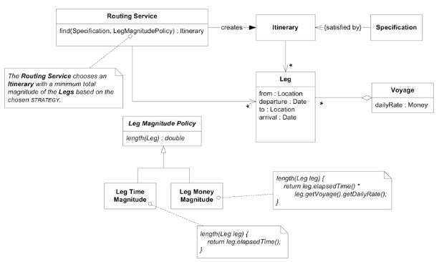
Strategy (Policy) in Domain Model

Slide 37
Refactoring Toward Deeper Insight

Slide 38

Things to Focus On
There are three things you have to focus on:
Live in the domain.
Keep looking at things a different way.
Maintain an unbroken dialog with domain experts.

Slide 39

Sources of Knowledge
The process of brainstorming for missing concepts and better models has a great capacity to absorb ideas from any source, combine them with local knowledge, and continue crunching to find answers to the current situation.
You can get ideas from books and other sources of knowledge about the domain itself.
Sometimes you can draw on the experience of others in the form of analysis patterns.

Slide 40

When to Refactor?
Refactor when:
The design does not express the team’s current understanding of the domain.
Important concepts are implicit in the design (and you see a way to make them explicit).
You see an opportunity to make some important part of the design suppler.
Refactoring toward deeper insight is a continuing process.

Slide 41
Key Takeaways

Slide 42
Key Takeaways
Continuously refactor your model. This creates a potential for a breakthrough of insights.
Make implicit concepts explicit to improve the model.
Make your design supple:
Express model through Intention-Revealing Interfaces.
Define Side-Effect-Free Functions to make interfaces safe and simple.
Make side effects explicit by introducing Assertions.
Simplify interpretation of model by introducing Standalone Classes.
Use Closure of Operations where it simplifies the design.
Draw knowledge from Analysis Patterns and books about the domain.
Use Design Patterns in Domain Model when they correspond to domain concepts.
Notes:
Good example of policy strategy: classic and annuity loan payment scheme

Slide 43
Q&A

